Slide 1
Sage Academy – How it started
Caoimhe, Natalia, Aoife, Lee

Slide 2
Table of contents
01
Introduction & Theme
02
Research & User Insights
03
Goals & Value Proposition
04
Preliminary Designs & Feedback

Slide 3
Table of contents
05
Development & Responsiveness
06
Testing, Optimisation & Deployment
07
Reflections & Future Steps

Slide 4

01
Introduction & Theme

Slide 5
Team Members
Caoimhe
Natalia
Aoife
Lee
Team Co-Leader
UX/UI designer
Web Developer
Team Co-Leader
Responsive Designer
Web Developer
Web Developer
Researcher
Supporting Researcher

Slide 6
Theme
The theme of our website is “Education”.
With our website, we wanted to create an app which focuses on enhancing student experience while also giving educators a platform to communicate and assess their students. Our website integrates interactive features to allow for resource sharing. This space fosters a dynamic and supportive learning environment, ensuring students receive the resources that they need to succeed.

Slide 7

02
Research & User Insights

Slide 8

In our research, we analysed 4 other websites that also focused on education that we had used in the past.
We researched them under the headings of: “Usability”, “Responsiveness”, “Accessibility”, “Aesthetics”, “Content Quality”, “Interactivity”, and “Consistency”.
We also created User Personas and low fidelity wireframes, then we role played as these personas through the wireframes.

Slide 9
Website Comparisons
Blackboard | Khan Academy | Kahoot! | Studyclix
We liked the consistent aesthetic. It’s also very accessible and has a mobile version. However, it has small inconsistencies, and the layout/ structure can be confusing for new users. | We liked the sub-sections and headings as well as the interactivity and responsiveness. We also liked the consistent use in the layout and logos. However, we found some problems with accessibility on smaller screens. | Kahoot scored well in almost every aspect of the research, it had consistent layout, navigation, accessibility and aesthetics. The only criticisms we made were that the homepage doesn’t have proper headings, and the website can be overwhelming with bright colours. | The user interface and interactivity were highly effective and well-executed. However, the accessibility was limited and there was no alt text to the pictures

Slide 10
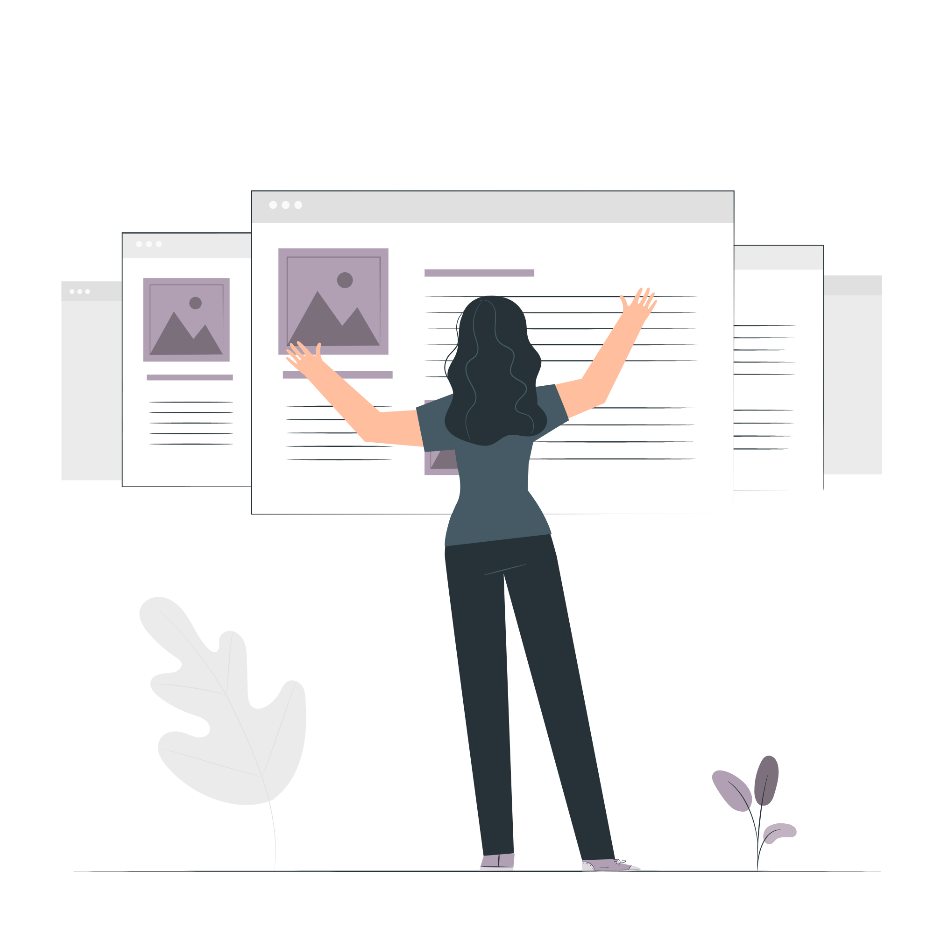
We created 4 User Personas to represent different demographics of potential users, we had;
a lecturer in their mid-40s who is not familiar with newer technologies,
a student who is a first-time user of the website,
a young lecturer who suffers from a lack of engagement from students,
and university administrator who often finds it difficult to find and utilise the necessary tools as educational interfaces often cater towards students or educators.

Slide 11

Environmental Factors
We got a lot of valuable feedback from getting different people to roleplay as these personas and do specific tasks which we incorporated to our wireframes, and we kept these corrections in mind while creating the website.
We then conducted a series of tests by simulating different noise-level environments to assess their impact on usability. These environments ranged from quiet settings to high-noise scenarios, allowing us to observe how varying levels of ambient sound influenced the user's ability to interact with the interface and complete tasks efficiently. This helped ensure the design remained effective under real-world conditions.

Slide 12

03
Goals & Value Proposition

Slide 13
Project’s Purpose
The main purpose of our website is to be used as an educational tool to be used by college students and their lecturers, using our websites intuitive quizzes and learning resources to get a greater grasp on their education.

Slide 14
Our Goals
We had some goals set in place that we wanted to achieve for our website. These consisted of
Signing in/Signing out
Creating topics/modules
Taking quizzes
Multiple modules
Learning resources
Tracking academic progress

Slide 15
Our website gives both students and lecturers improved learning opportunities.
Our website appeals to students looking to get a greater understanding of their courses through quizzes and resources allocated by their lecturer.
Due to the lack of college education tools available we believe our website will attract users because of the demand and lack of other websites in the college education market.

Slide 16
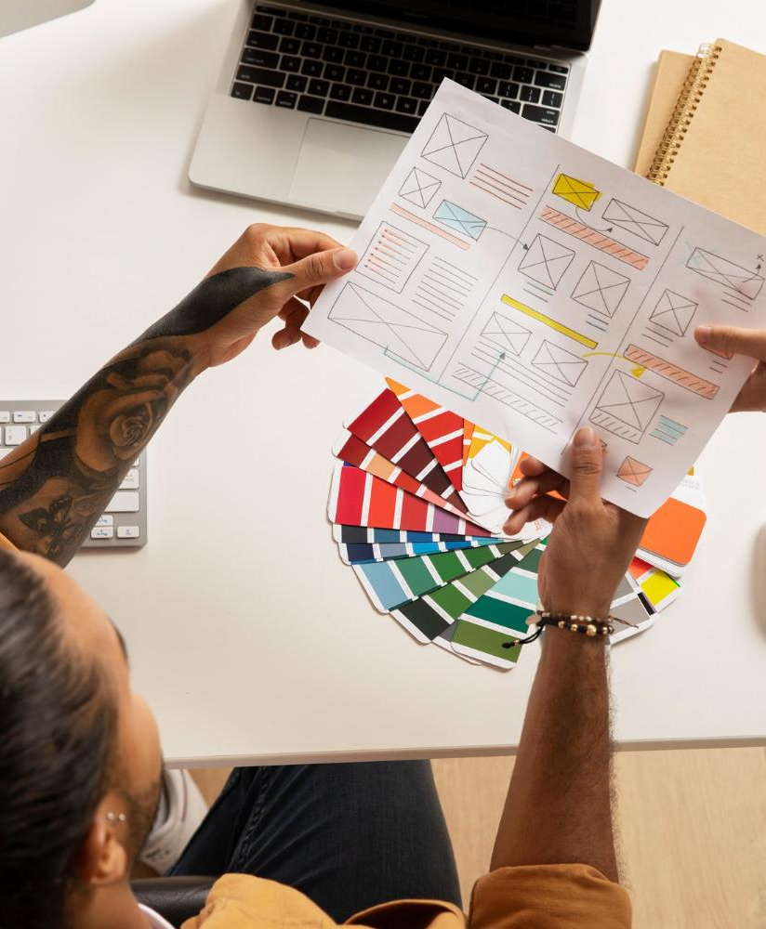
04
Preliminary Designs & Feedback

Slide 17
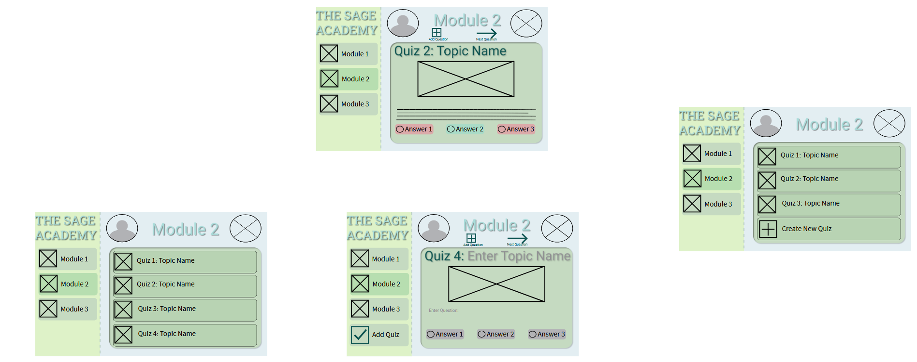
Wireframe
There was no create quiz page for the wireframe.
Now it has been added to the staff’s page.
From the feedback by our peers, they said that the ticks and crosses for adding new modules was helpful and easier to understand.

Slide 18
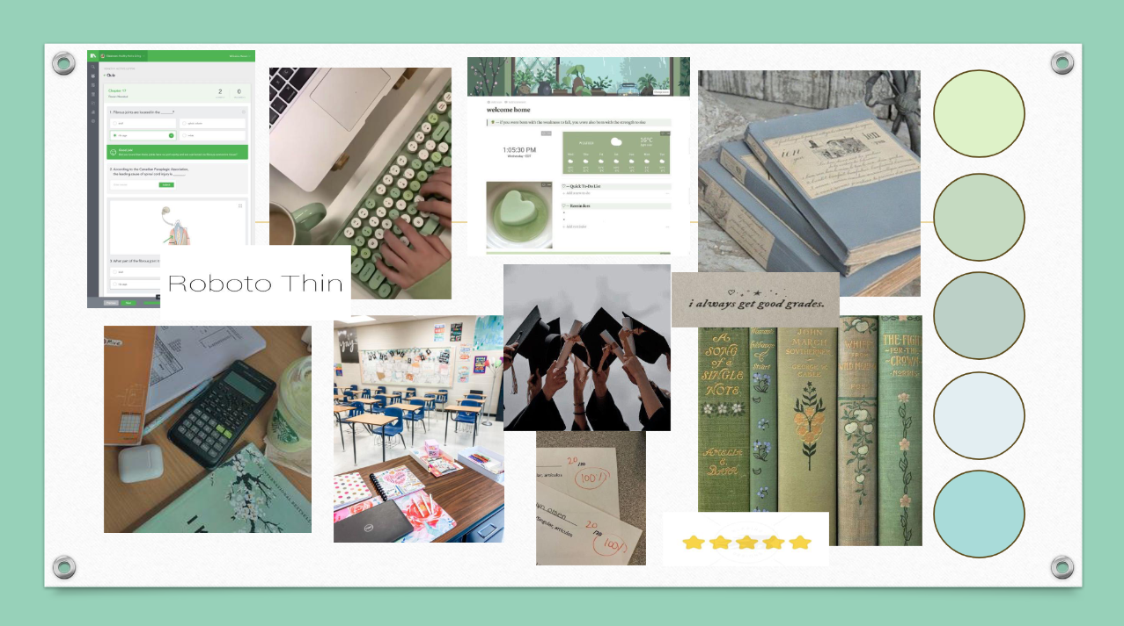
Mood Board
Neutral colours and universal font choice were nice to include, however it was very cluttered.
We have since shifted things around to make it look more organised.

Slide 19
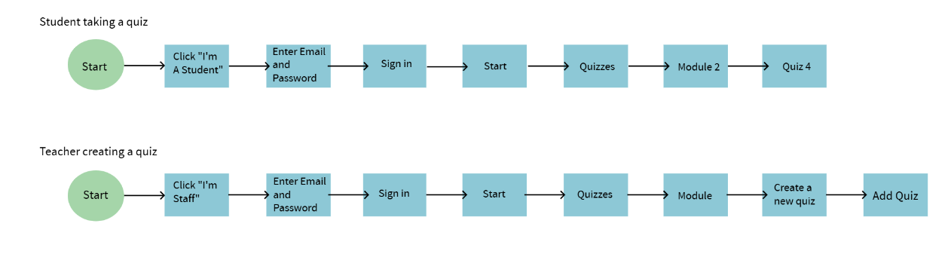
User Flow
There was only one colour, and one shape used throughout the whole user flow, making it confusing to follow. They were all blue and rectangle, making it difficult to differentiate between each other.
We decided to make the starting point a green circle, making it easier to understand where it begins.

Slide 20
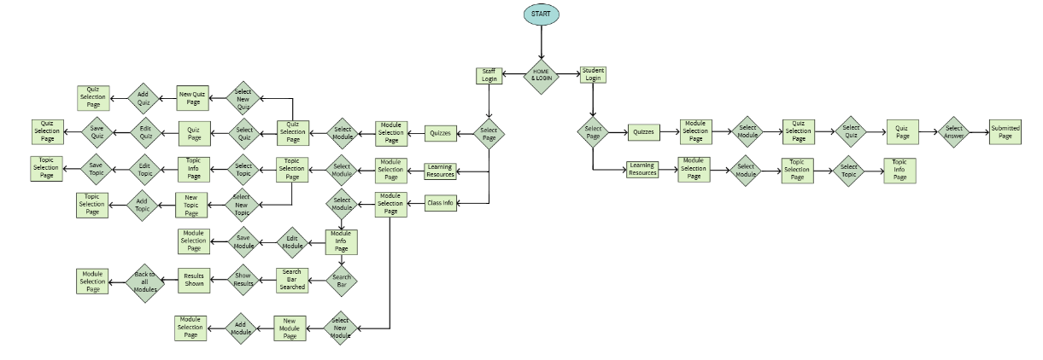
Site Map
We have since made it neater to understand more clearly. There was also good feedback on the colour palette used.
It was well structured but a little overwhelming.
This occurred due to the number of possibilities that our website could possibly have.

Slide 21

05
Development & Responsiveness

Slide 22
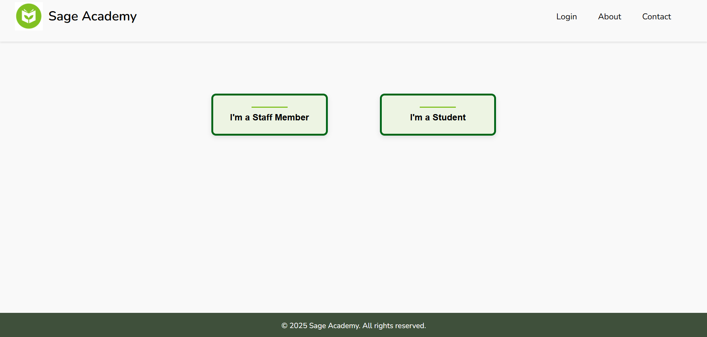
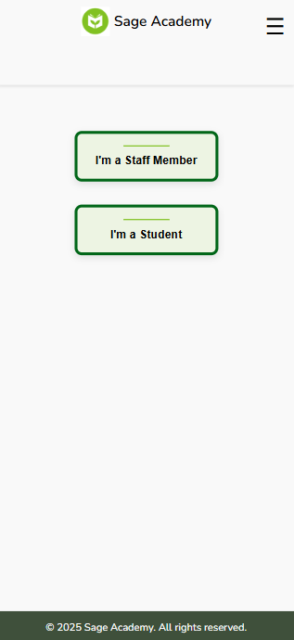
Responsiveness

Slide 23
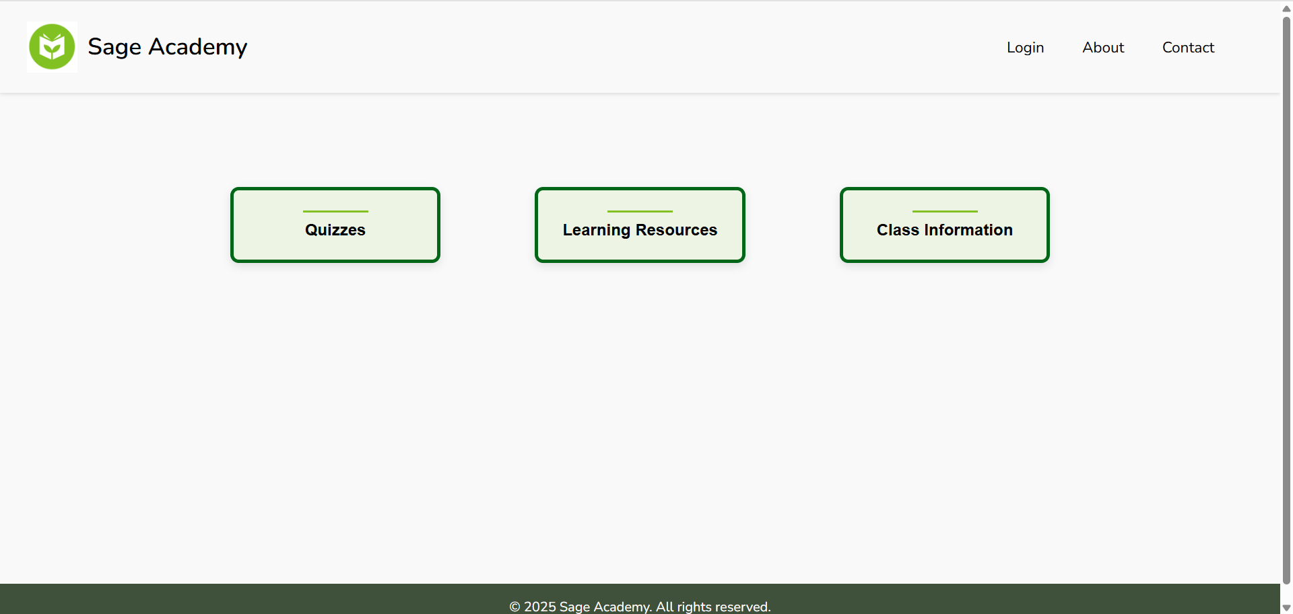
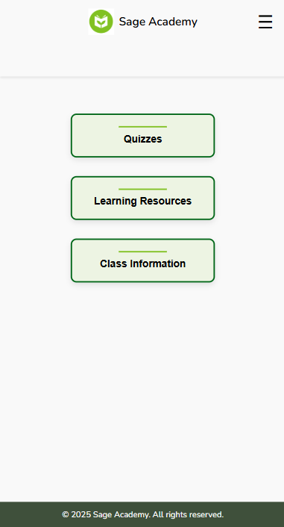
Desktop
Mobile

Slide 25

06
Testing, Optimisation & Deployment

Slide 26
Testing
Our main issue throughout the project was finding the correct styling for our website.
01
02
03
04
Using buttons instead of cards
Making a nav bar for the modules
Changed the overall visual for consistency
Didn't include extra images that were shown in the wireframes

Slide 27
Main Lessons
One
Two
Three
Make things simple
Use one consistent styling of buttons/cards/etc.
Keep to the colour palette

Slide 28

07
Reflections & Future Steps

Slide 29

Potential Enhancements
If we were to do this project again, I think we would make our goals more realistic with the features that we wish to include.
Since we are not utilising databases, some of the features that some of the more complex features we originally planned were not feasible without the necessary backend infrastructure.
By scaling down our feature set and focusing on the core functionality, we could ensure a realistic and more polished final product.

Slide 30

Biggest Takeaways
The biggest takeaway from this project is the importance of not overloading the project with difficult features. While ambition is important, prioritizing functionality and making sure that your goals are reasonable for your timeline/ skills is important. Focusing on key features help to maintain quality and avoids any of the team members becoming overwhelmed.
Another important takeaway would be clear communication and well-defined goals. Clear goals and communication help to keep the project focused and prevents misunderstandings; it also ensures that the team stays focused and can collaborate effectively.

Slide 31
Thanks!
Any questions?

